Slide 1
Motion Control using Motion Profile
FRC Team 3654
1/20/2018

Slide 2
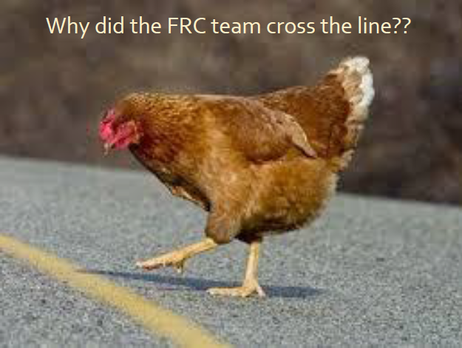
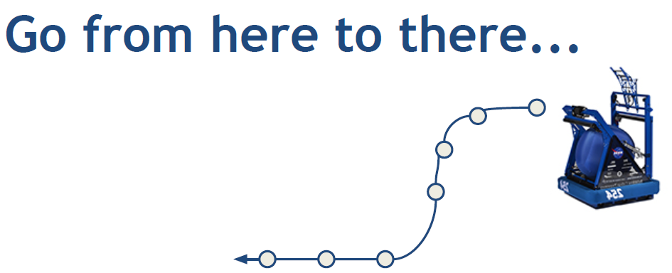
Motion Control – Automated Motion
Motion Control is about:
Applying what voltage at what time ?

Slide 3
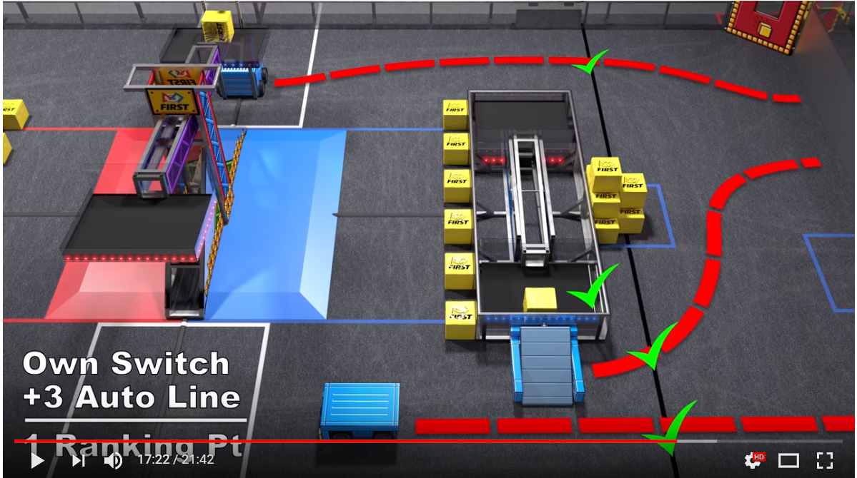
Autonomous Move in FRC 2018 Game

Slide 4
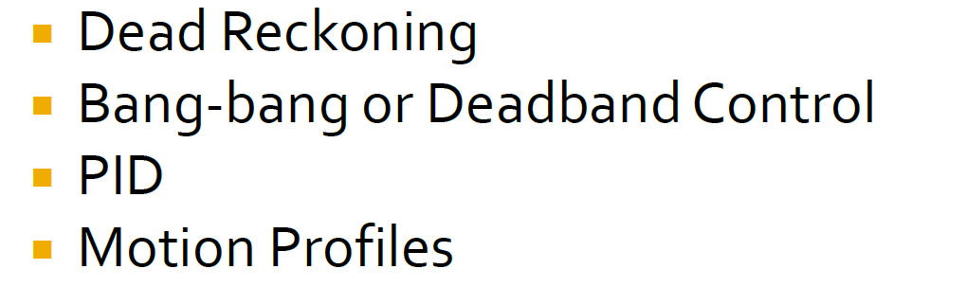



Motion Control Methods
Constant voltage at constant time
Constant voltage at variable time
Variable voltage at variable time
Specified voltage at specified time
Two main references that this deck is based on:
https://www.indianafirst.org/files/Motion_Control_in_FRC.pdf
https://www.chiefdelphi.com/forums/attachment.php?attachmentid=18971&d=1430850503
Motion Planning and Control for FRC.pdf by Jared Russell from Team 254

Slide 5
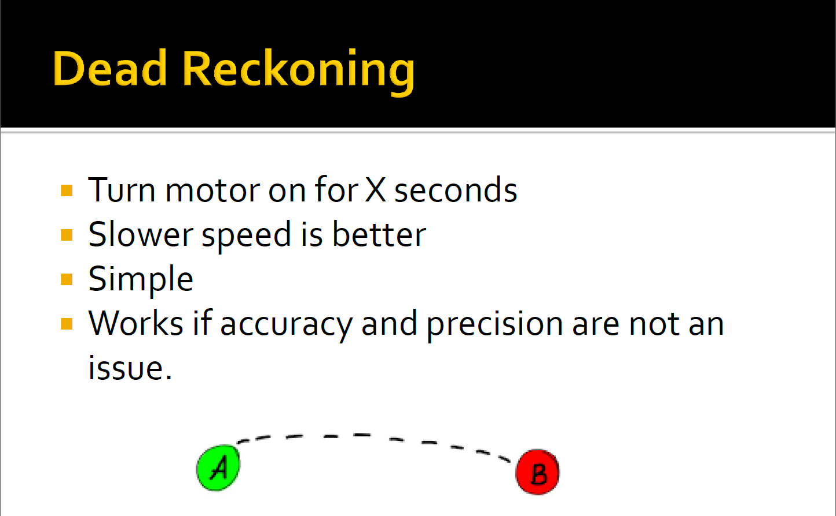

Slide 6
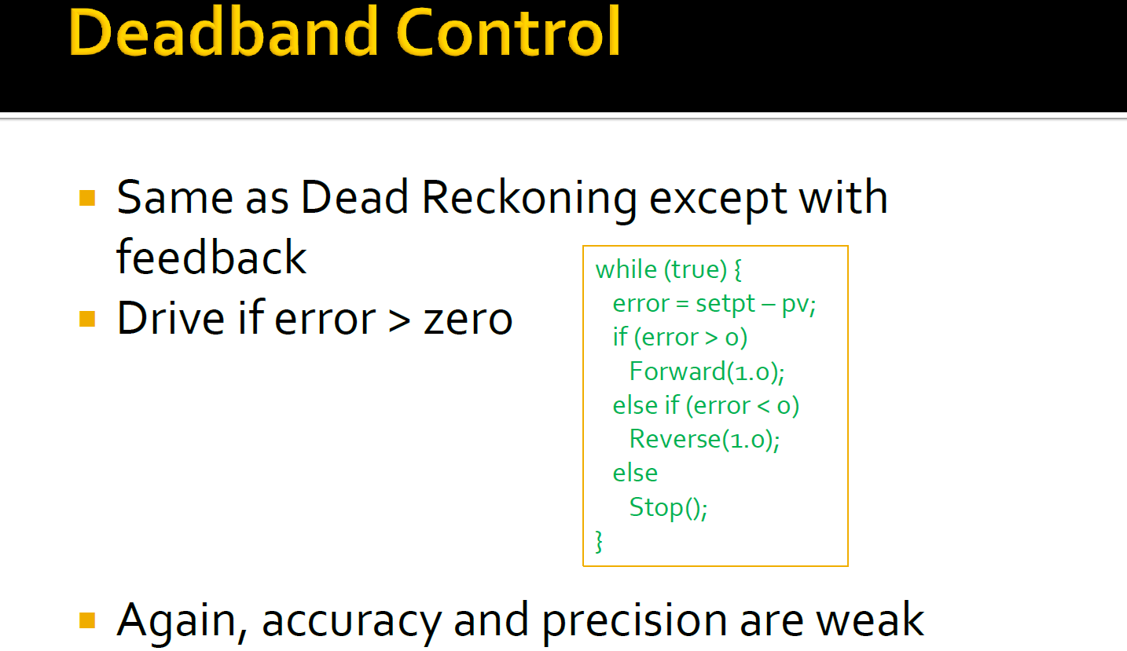

Slide 7
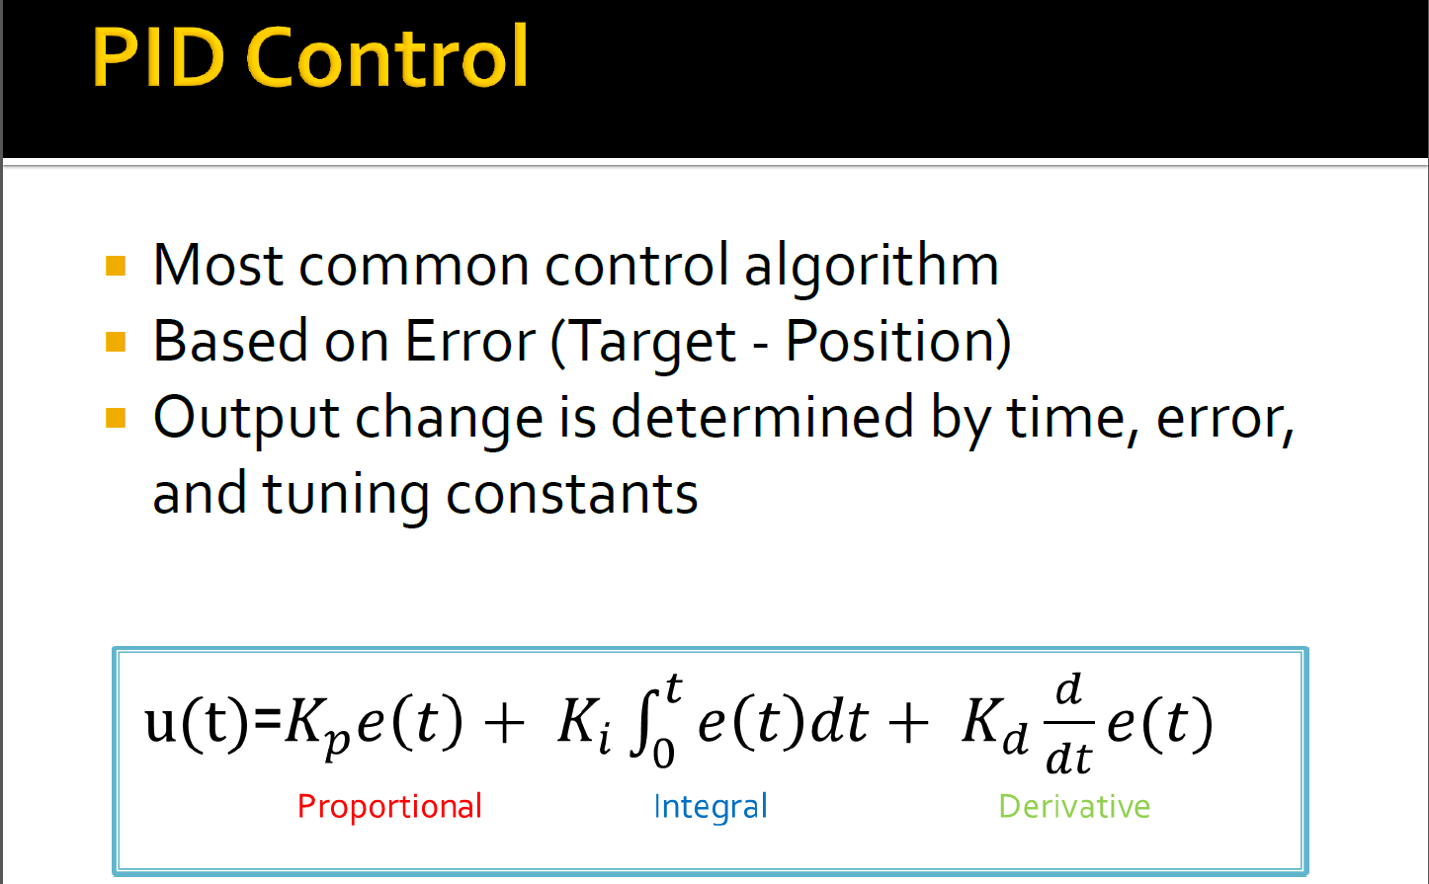

Slide 8
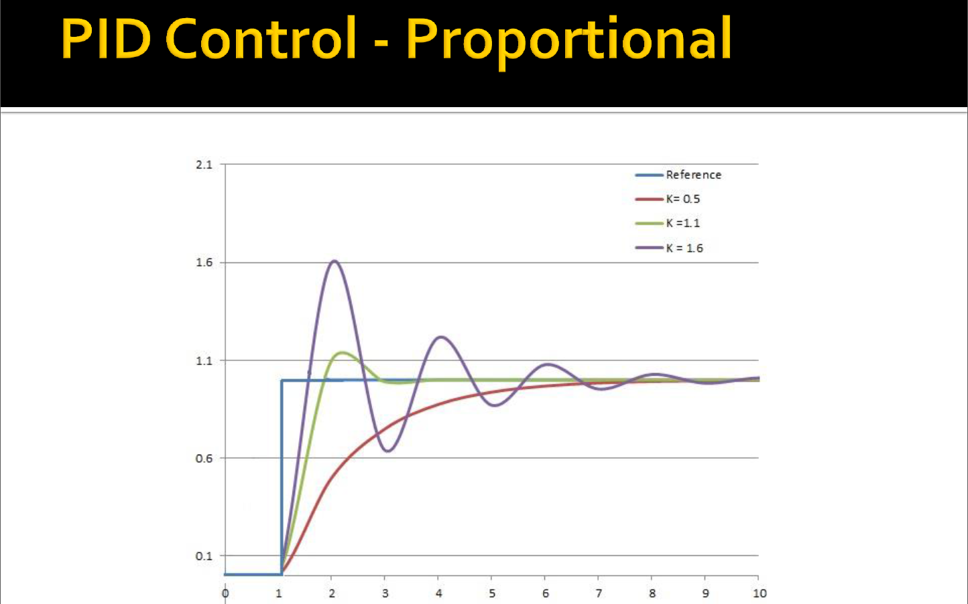

Slide 9
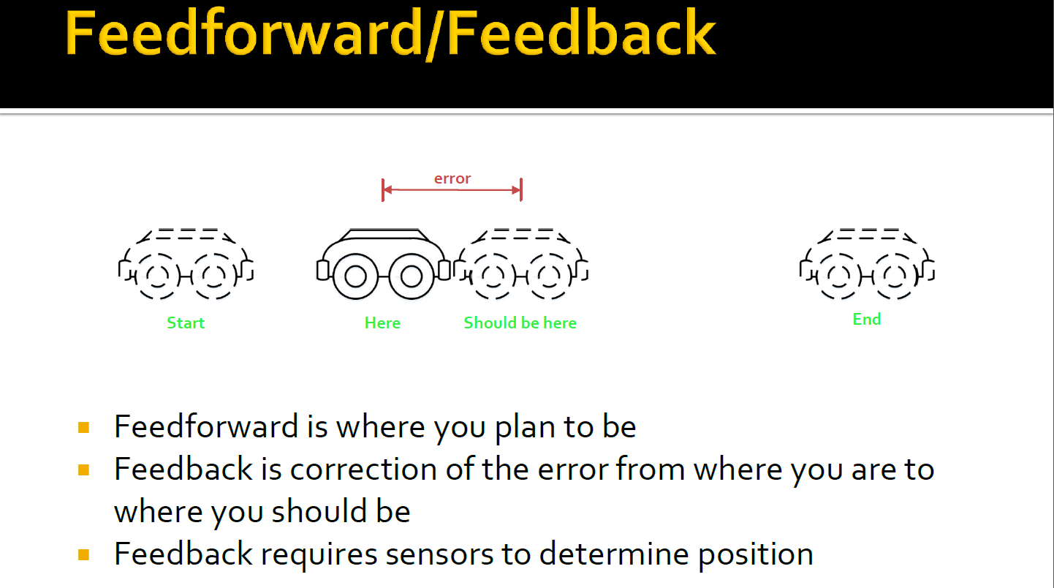

Slide 10
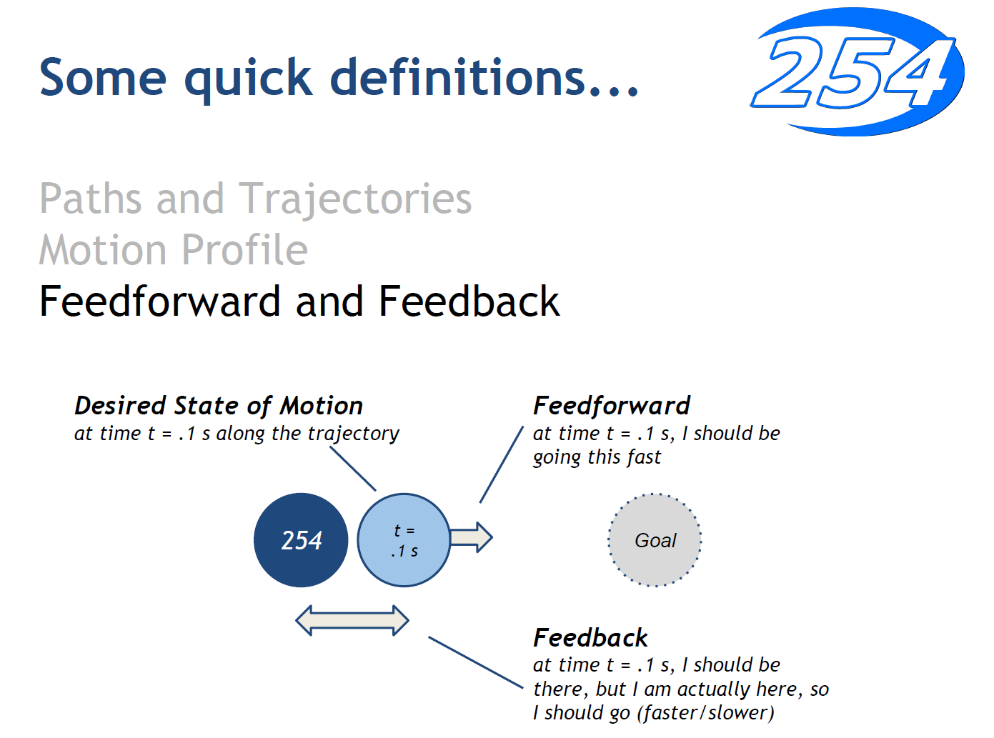

Slide 11
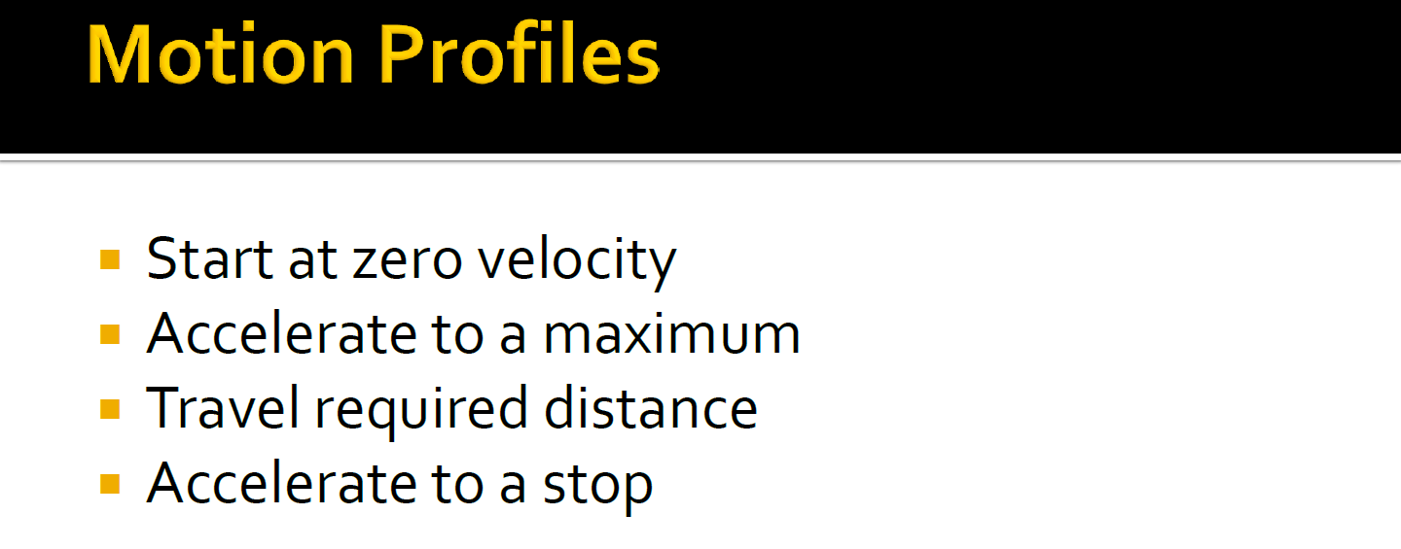
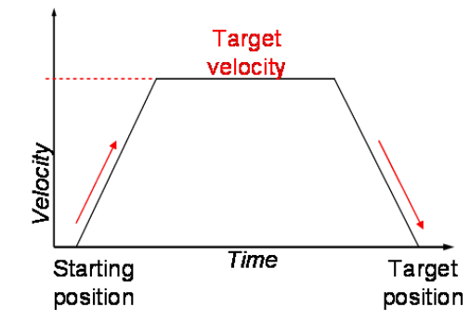

Slide 12
Why Motion Profile ?
Allows fine control of position and speed throughout the entire movement
Less slippage : slowly increase the speed
Highly repeatable :
Can do curve motion: different speed/position for left and right side

Slide 13
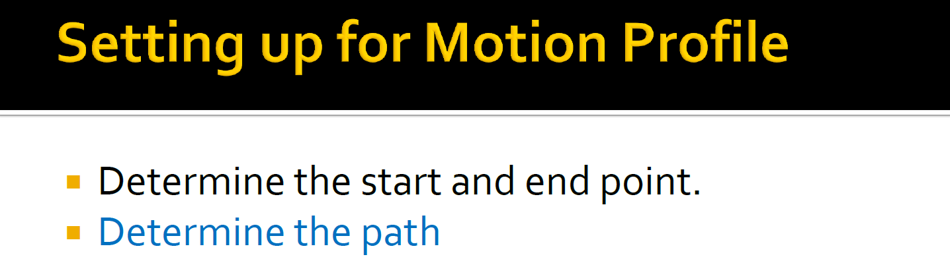
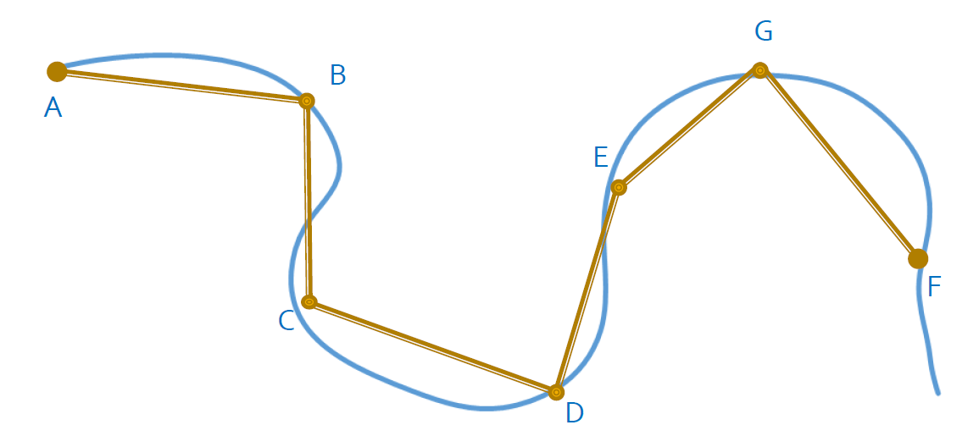

Slide 14
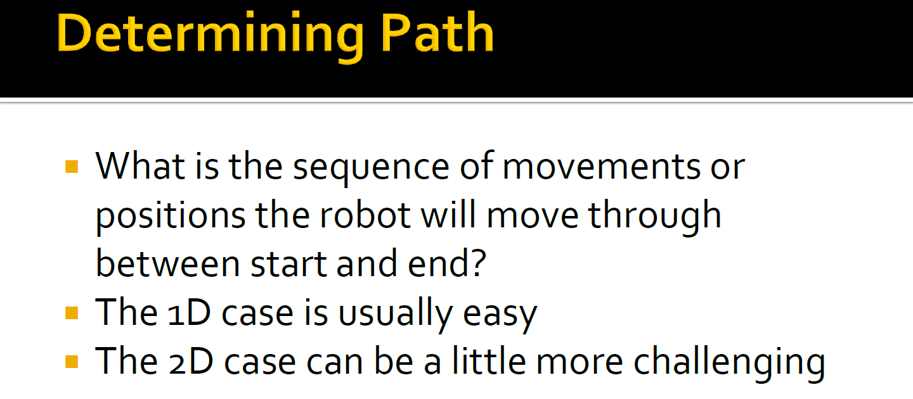

Slide 15
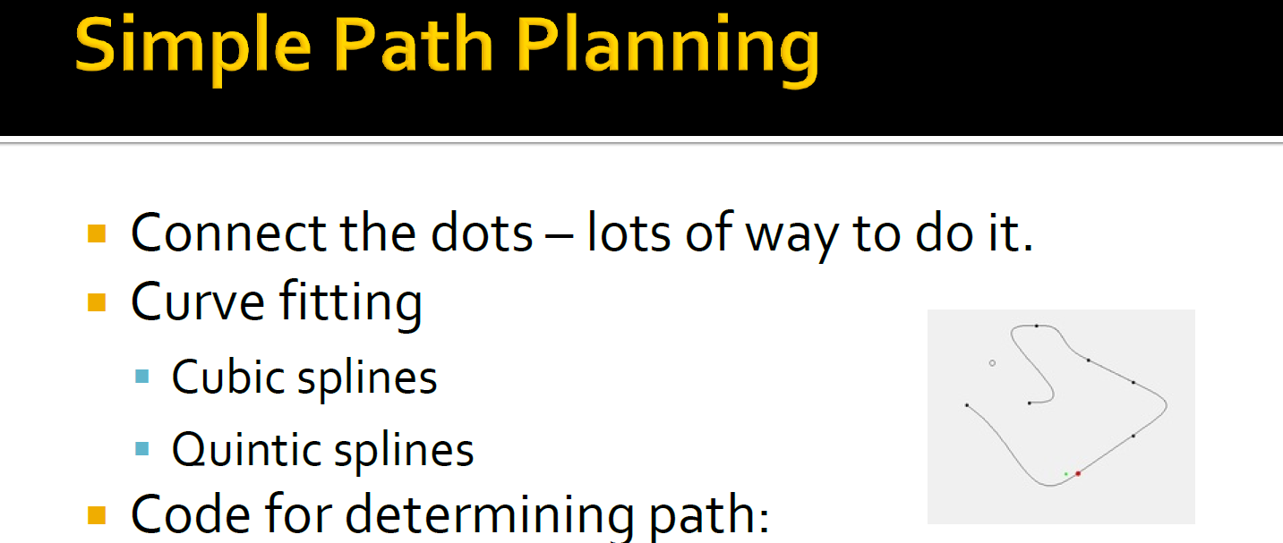
Pathfinder by Jaci https://github.com/JacisNonsense/Pathfinder
TrajectoryLib from Team 254 https://github.com/Team254/TrajectoryLib
Motion Profile Generator.xlsx from CTRE Talon Documentation Github

Slide 16
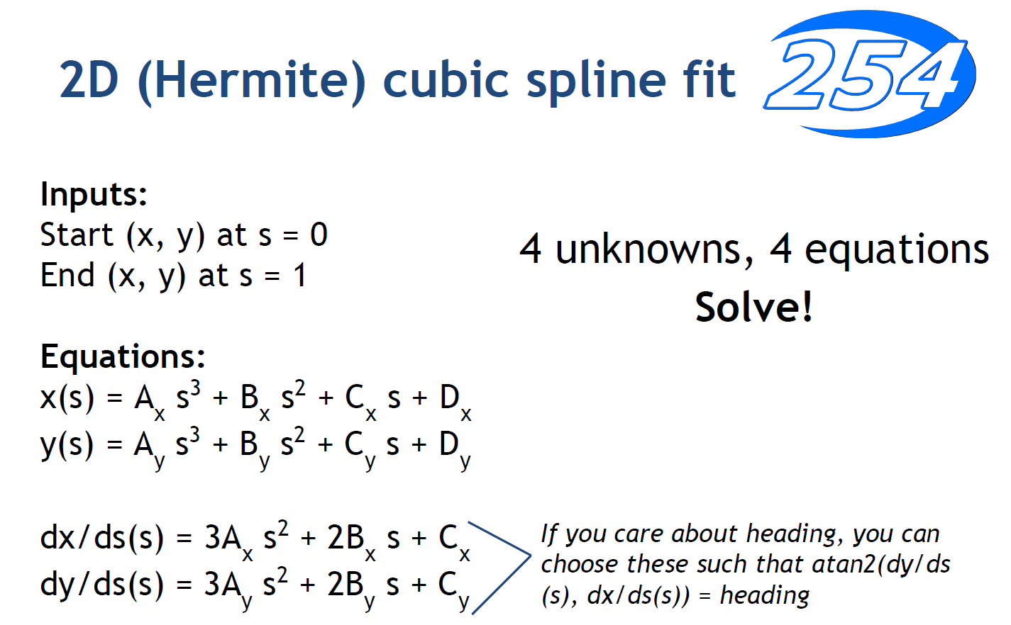

Slide 17
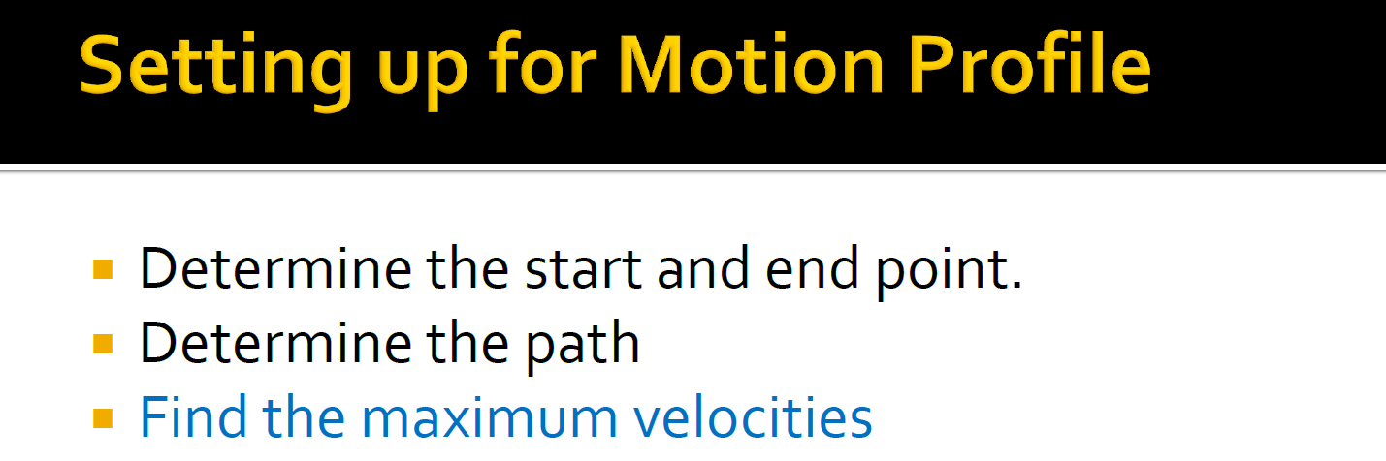
Max velocities is used to calculate the Feedforward F
F gain is multiplied directly by the set point

Slide 18
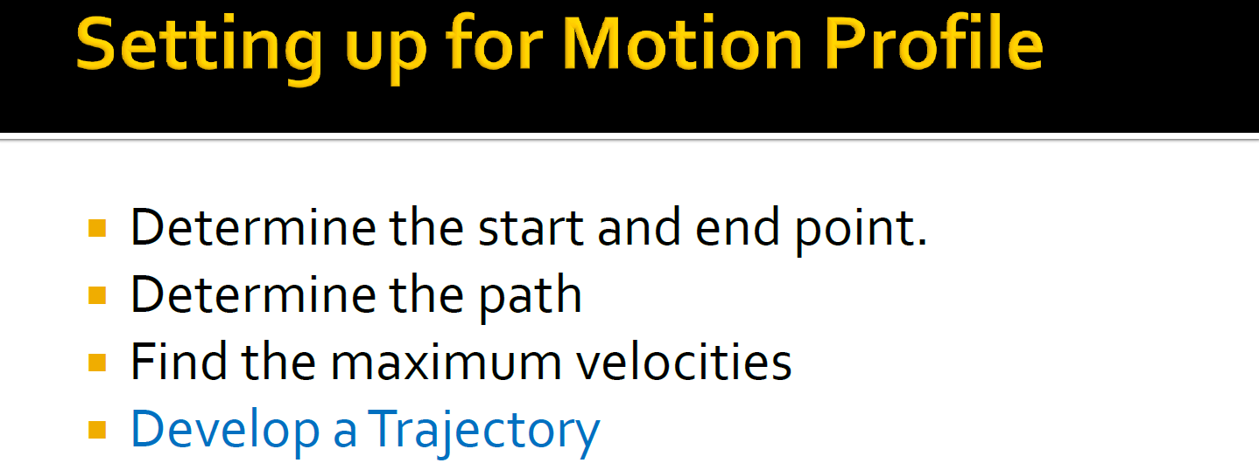

Slide 19
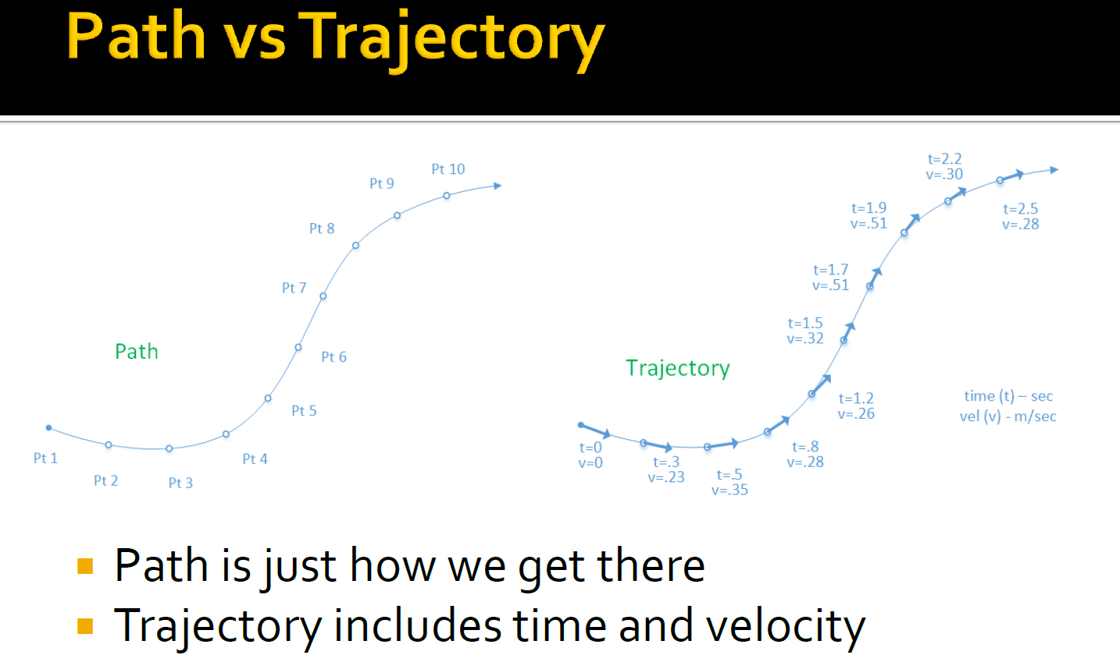

Slide 20
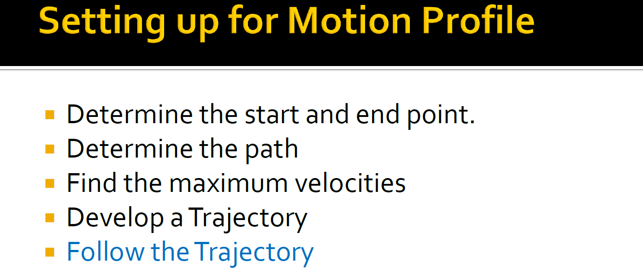
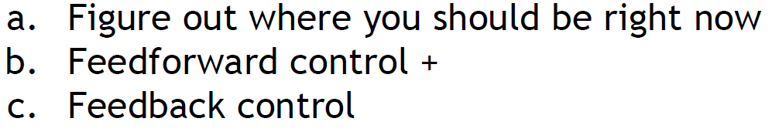

Slide 21
Two Ways to Execute/Follow Trajectory
Preferred way is to use Talon SRX’s built-in Motion Profile mode
Accurate loop time: firmware timer is better than packet cycle time
Higher frequency: 1000 HZ(1 ms) vs 50 HZ (20 ms)
Drawback: cannot incorporate other sensor data like Vision
Homegrown velocity closed loop to execute the profile
Less accurate, probably good enough for FRC needs
Can incorporate other sensor data like Vision and Gyro
Fully controlled by programmer instead of firmware
used as a fallback plan if the Talon SRX cannot satisfy the need

Slide 22
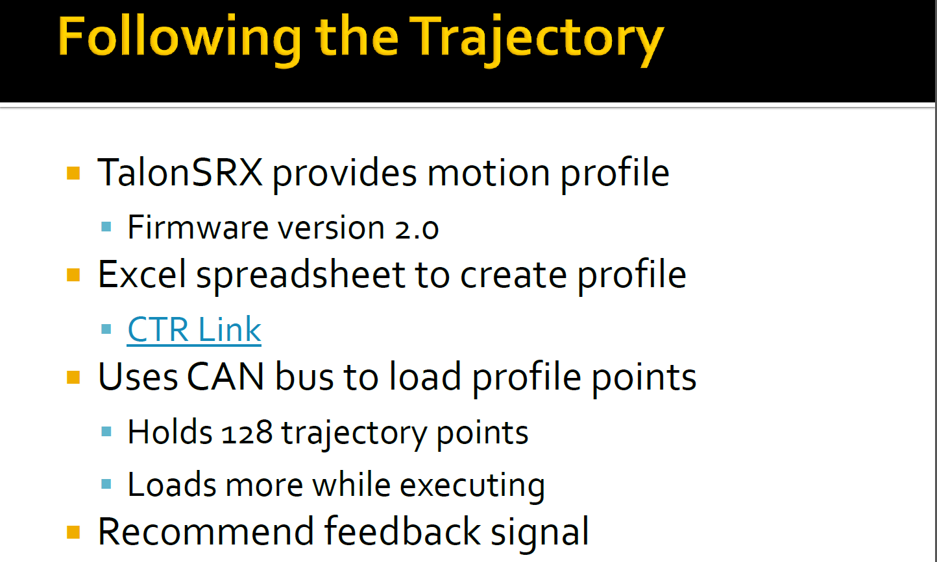

Slide 23
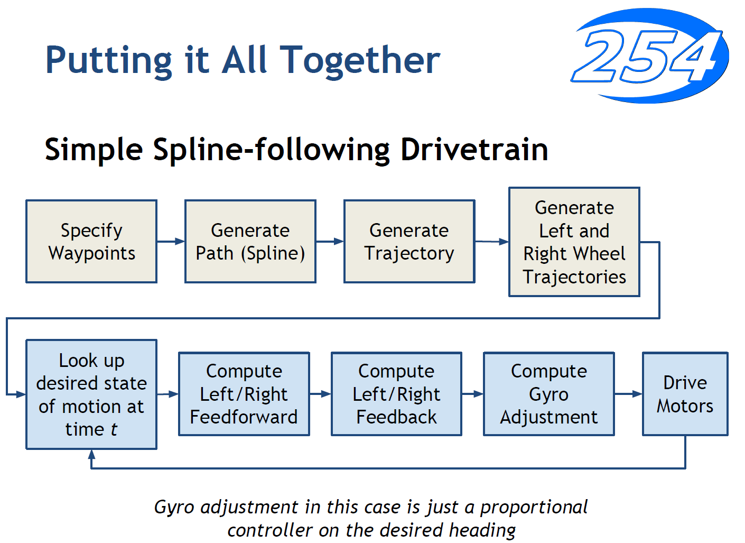

Slide 24
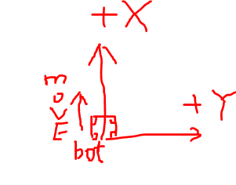
Motion Profile in Practice
Determine the key point in the path (called waypoints) in terms of (x,y) coordinate
Robot forward facing is +X, the right hand is +Y
From middle point to switch: (0,0) → (96 inches, 54 inches), heading 0 (no change)
Use Jaci’s Pathfinder to generate the path
Download Eclipse: http://www.eclipse.org/downloads/ OXYGEN or NEON
Download the compiled Pathfinder jar from https://github.com/JacisNonsense/Pathfinder/releases/download/1.5/Pathfinder-Java.jar
Open Eclipse, create a new project, give a name like “Pathfinder3654”
In new project, add a new class called “Tank”, copy our code into Tank.java
In project’s properties ->Java Build Path (at left panel) -> Libraries -> Add External Jars: Pathfinder-java.jar
In Tank.java, need set Max Velocity (like 1.7 m/s), Max Acceleration( like 2.0 m/s/s), Max Jerk(like 60 m/s/s/s)
In Tank.java, need set Waypoint[] array based our key points in our path
A few other parameters: like step time, file name, wheelbase width
Run as Java application to generate the Motion Profile file like mp_20ms_in_meter.csv which contains the left and right position and velocity and step time for each point in trajectory.
Use WinSCP to upload the file to RoboRIO
Download WinSCP if you have not installed one
Upload file to /home/lvuser folder in RoboRIO
Detail instruction in “Generate Motion Profile Trajectory using Eclipse.docx” in Google shared “Doucment” folder

Slide 25
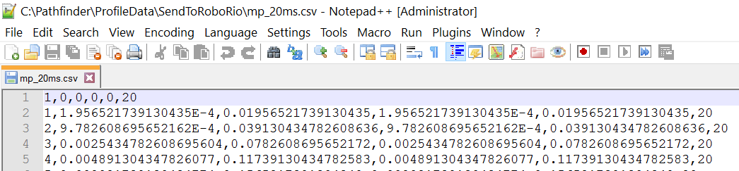
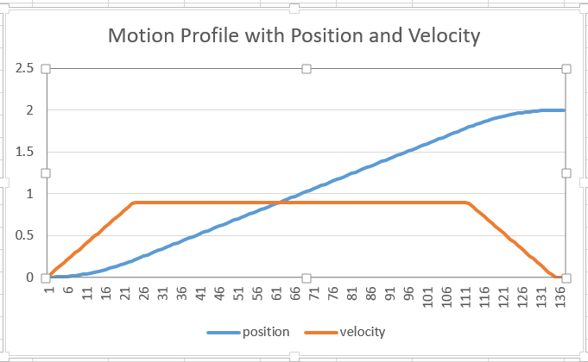
Motion Profile in Practice

Slide 26
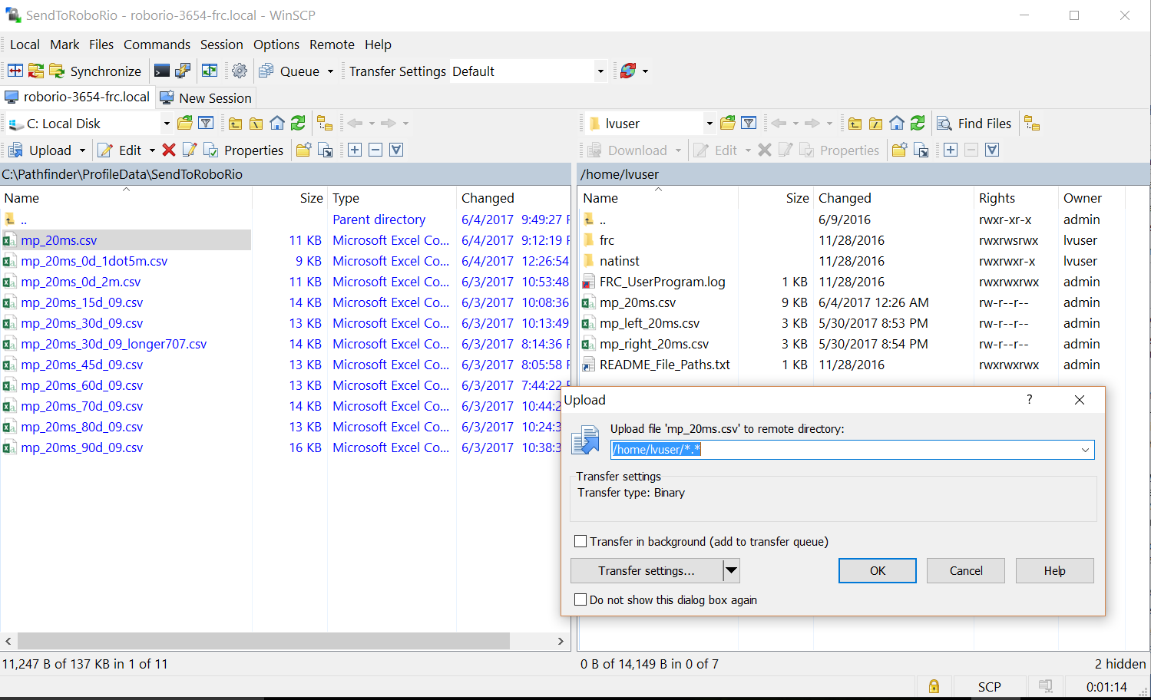
Motion Profile in Practice

Slide 27
Motion Profile in Practice
Motion Profile LabView Project
Start from CTRE’s sample project :
It need buffer a certain # of point first
Small delay to start. Much better in new version, < 200 ms delay
It only shows how to control one motor
Some code change to handle both left/right side
Some code change to handle master/slave relationship if invert is needed
It only has teleop example, no autonomous example
need manage the buffer and path selection
Profile could be pre-loaded/pre-buffered (optional):
up to 4 slots for 4 different profiles
No delay in auto if the profile is pre-loaded
Delay may not be significant in new version (< 200 ms delay)
The motion profile LabView project need be in another documentation – TBD

